Slide 1



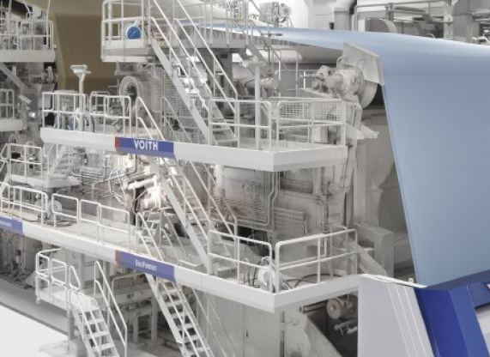
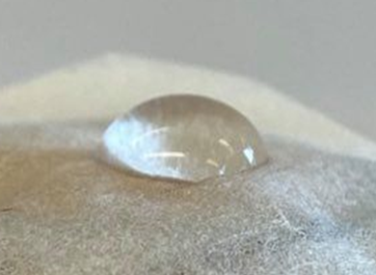


Treesearch and WWSC Academy, Summer School 2020
Topic; Surface and colloidal properties of wood based fibers and nanofibrils
2.0 ECTS credits
Site visit to SCA
August 24-28, 2020, Södra Berget and Sundsvall
Contact Information:
Prof. Gunnar Westman & Prof. Paul Gatenholm
westman@chalmers.se & paul.gatenholm@chalmers.se

Slide 2
Treesearch and WWSC Academy, Summer School 2020
Topic; Surface and colloidal properties of wood based fibers and nanofibrils
2.0 ECTS credits
Site visit to SCA
August 24-28, 2020, Södra Berget and Sundsvall
Lecturers: Lars Wågberg, Magnus Norgren, Krister Holmberg, Björn Lindman, and guests
Day 1: Fundamentals of surface active agents
Day 2: Surfactants and polymers in solution
Day 3: Mixed surfactant-polymer systems
Day 4-5: Implications in lignocellulosic processes and
utilization in materials design

Slide 3
Treesearch and WWSC Academy, Summer School 2020
Topic; Surface and colloidal properties of wood based fibers and nanofibrils
24 August, Day 1:
12.00 Lunch
12.40 Intro to course
13.15 Fundamentals of surface active agents
- Introduction to the course
- Surfactants – structures and propertries
- Coffee break
- Surfactants – structures and properties, cont.
- Break
- Environmental and health aspects of surfactants
- Surfactant micellization, association of surfactants
17.30 Get together, project selection
19-20 Dinner
20.30 Social activities

Slide 4
Treesearch and WWSC Academy, Summer School 2020
Topic; Surface and colloidal properties of wood based fibers and nanofibrils
25 August, Day 2:
08.30 Surfactant and polymer systems
- Surfactant micellization, cont.
- Concentrated surfactant systems
- Coffee break
- Surfactants and polymers containing polyoxyethylene groups
- Adsorption of surfactants at solid surfaces
12.00 Lunch
13.00
- Aqueous polymer systems
- Polymer adsorption at solid surfaces
- Coffee break
- Mixed surfactant systems
16.15-18.00 Outdoor activities
18.00-19.00 Dinner
19.00 Project work

Slide 5
Treesearch and WWSC Academy, Summer School 2020
Topic; Surface and colloidal properties of wood based fibers and nanofibrils
26 August, Day 3:
09.00-11.00 Surfactant and polymer systems (cont.)
- Surfactant-polymer systems
- Coffee break
- Wetting and wetting agents, hydrophobation and hydrophobizing agents
11.30 Lunch
12.30 Bus to study visit SCA
13.00-17.00 Study visit and SCA lectures
17.15 Bus to hotel
18.00-19.00 Dinner
19.00- Project work

Slide 6
Treesearch and WWSC Academy, Summer School 2020
Topic; Surface and colloidal properties of wood based fibers and nanofibrils
27 August, Day 4:
09.00-12.00
Physicochemical properties of wood polymers
12.00 Lunch
13.00-16.00
Physicochemical properties of fibers and nanofibers
16.15 Outdoor activities
17.30 Project work
18.30 Dinner
19.30 Project work

Slide 7
Treesearch and WWSC Academy, Summer School 2020
Topic; Surface and colloidal properties of wood based fibers and nanofibrils
28 August, Day 5:
08.30-09.30 Lecture
10.00-11.30 Project presentations
11.30 Lunch and departure

